Slide 1
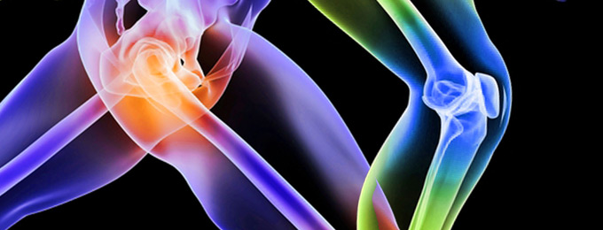
Joint replacements (hips and knees): What has happened to my joints, What is a new joint like, preparing for joint surgery, recovery after joint surgery?
http://www.aaos.org/store/product/?productId=19984&ssopc=1

Slide 2
What has happened to my joints?
Joints can be damaged by arthritis and other diseases.
Arthritis or simply years of use may cause the joint to wear away.
Diseases and damage inside a joint can also limit blood flow, causing problems.
Excess weight can also put added pressure on joints allowing for greater wear and tear.
Old sports injuries can impact the integrity of joints.

Slide 3
What is a new Joint like?
A new joint, called a prosthesis can be made of plastic, metal, or both. It may be cemented into place or not cemented, so that your bone will grow into it. Both methods may be combined to keep the new joint in place.
Cemented prosthesis are typically used in older adults to help fortify possible brittle bones.
Un-cemented prosthesis are commonly used in younger adults or adults that do not manifest brittle bones.
Most replaced joints are made of cobalt-chromium alloys. Theses semi metals are hard, tough, corrosion resistant, and strong enough to with stand wear and tear that are necessary for joints.

Slide 4
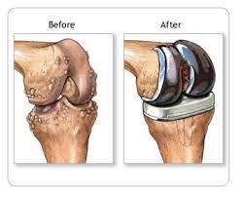
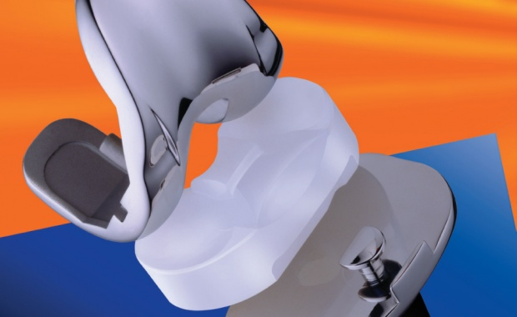
New Knee
Cobalt chromium alloy with plastic patella insert.
http://www.aaos.org/store/product/?productId=19984&ssopc=1
http://www.aaos.org/store/product/?productId=19984&ssopc=1

Slide 5
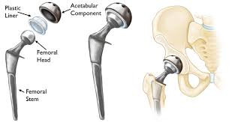
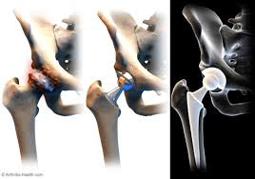
New Hip
Cobalt chromium alloy ball and socket with plastic liner and alloy femoral stem.
http://www.aaos.org/store/product/?productId=19984&ssopc=1

Slide 6
Preparing yourself for joint surgery
You want to face surgery with the strongest and healthiest body possible. To ensure this attention should be made to:
Nutrition - Eat healthy foods and drink adequate water in the time leading up to surgery. Protein will help your bones and muscles recover from surgery. Avoiding caffeine during this time will also help with fluid balance after surgery. (Leach, Spaulding, Thomas, Conn,and Kutash, 2013)
Medications - Make a careful list of all medications you take, including prescription drugs as well as over-the-counter items. Your doctor may recommend tapering off and stopping certain medications before your surgery date, as they can impact bleeding during the operation

Slide 7
Preparing yourself for joint surgery
Stop Smoking - Smoking impacts your blood vessels and lungs, and can slow your recovery from surgery.
Exercise – Consult your doctor as to which exercise if any should be done before surgery.
Rest – get adequate rest leading up to the surgery you will want to go into the surgery well rested.
Attitude - It’s a good idea to prepare yourself mentally and emotionally for these realities, gathering your inner strength and focusing on the ultimate outcome of better mobility.
Blood Donations -Talk to your doctor about the option of donating your own blood ahead of surgery to be used if you need a transfusion. (Bonfante, 2016)

Slide 8
Preparing your home for Joint surgery
When you return home from surgery, you will be dealing with post-surgical pain and will be less mobile than before while your joint heals. There are several things that should be done before leaving for the hospital to make your discharge to home smoother:
If you live in a two-story home, create a sleeping space downstairs for the first weeks following surgery.
Measure the width of your doors and hallways. You should have 30 inches of clearance in all areas you must navigate during the first few weeks

Slide 9
Preparing your home for joint surgery
Remove all throw rugs, cords and other obstructions to allow a wide path through the rooms of your home.
Place objects you will need frequently – clothing, cooking utensils, in locations so you can reach them without bending down or reaching up.
Assistive devices – after joint surgery you will need certain devices to aid in toileting, bathing, dressing, and picking items up.

Slide 10
Preparing caregivers and Loved ones
When you first leave the hospital you will need assistance in performing household activities. Arrange for family members or friends to be present.
In the cases that you may live alone, you may want to consider going to a specialized rehabilitation facility.

Slide 11
Recovering after Joint Surgery
While in the Hospital:
Post-Op Day 1
Your hospital stay will be 3-5 days depending on extent of surgery.
During your hospital stay after surgery you will be with in a lot of pain. Medications will make pain manageable, but will not take pain away completely.
Occupational Therapy and Physical Therapy evaluations will be done.
Goal: Sit at the edge of the bed with assistance.
Expectation: Begin transfers from bed to chair with assistance from therapists and nursing.

Slide 12
Recovering After joint surgery
While in the hospital, you will be prescribed activities and medication to prevent blood clots from forming in your veins.
Ice may be applied to your hip to help with swelling and pain control.
Post-OP Day 2:
You will be given a laxative at bedtime if needed.
Dressing change will be performed by rounding MD, NP or PA.
Goal: Two sessions of Physical Therapy morning and afternoon - Progression of strengthening and range of motion exercises.
Expectation: Progression of bed mobility, transfers bed to chair and back and walking

Slide 13
Recovering After joint surgery
Post-Op Day 3
Your nurse will review your discharge instructions, which includes any medications you will be taking at home, such as pain medication and Anticoagulation medication.
Goal: You will be independent getting in and out of bed.
Expectation: You will progress to being able to walk 150 feet alone.
You will also continue to work on strengthening exercises and improved functional mobility.

Slide 14
Recovering after joint surgery
Short-Term 6-12 weeks
You will continue to perform exercises to help your joint heal properly, minimize scar tissue and strengthen your muscles to support the new joint.
Patients who comply with a Physical Therapy regime tend to show greater improvements and range of motion mobility sooner than patients who do not comply.
With continued Physical Therapy ambulation with walker decreases and ambulation with crutches or cane begins.
Prescribed pain medication may be taking on an as needed basis.

Slide 15
Recovering after joint surgery
Long-Term 3-6 months
Long term recovery involves the complete healing of the surgical wounds and the internal soft tissues that were involved in the operation
You will have to be mindful about the potential for infection for the rest of your life.
You should also avoid high impact activities that will impact your new joint.

Slide 16
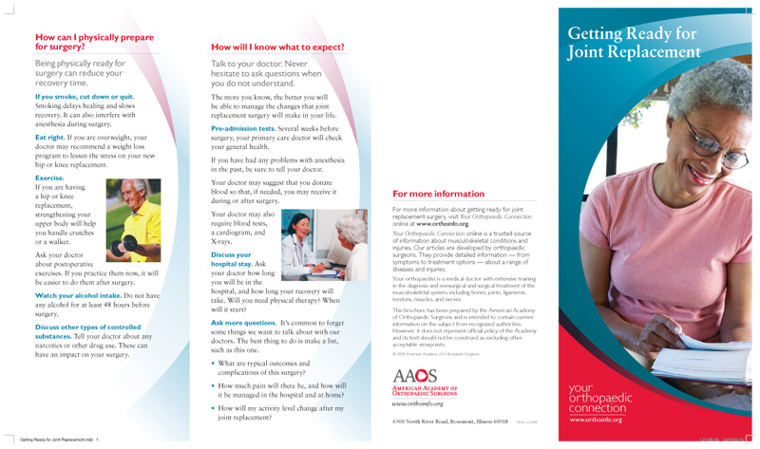
A-V Handouts
http://www.aaos.org/store/product/?productId=19984&ssopc=1

Slide 17
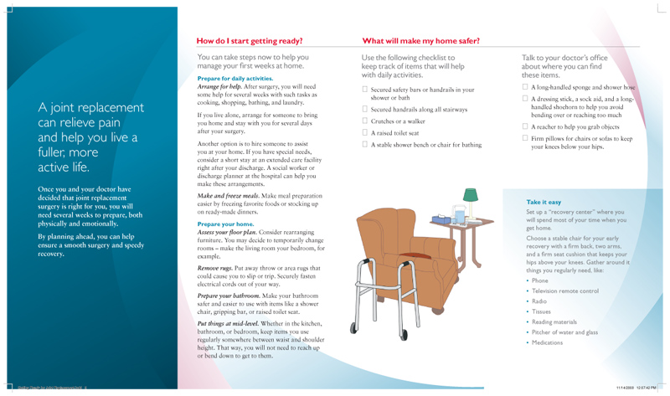
A-V Handouts
http://www.aaos.org/store/product/?productId=19984&ssopc=1

Slide 18
Reference:
American, the. (1995). Getting ready for joint replacement brochure (English). Retrieved October 3, 2016, from http://www.aaos.org/store/product/?productId=19982&ssopc=1
Blake, J. Recovery from knee replacement: What to expect after surgery. Retrieved October 1, 2016, from http://www.sutterhealth.org/orthopedics/knee/recovery- from-knee-replacement.htm
Bonfante, I. (2016). Blood transfusion practices in patients undergoing total joint replacement. Orthopaedic Nursing, 35(3), 183–186. doi:10.1097/nor.0000000000000247
2016. (1995). Joint replacement. Retrieved October 1, 2016, from http://my.clevelandclinic.org/health/treatments_and_pro cedures/hic_Joint_Replacement
Leach, D., Spaulding, J., Thomas, J., Conn, C., & Kutash, M. (2013). The effect of caffeine on Postoperative urinary retention after joint replacement surgery. Orthopaedic Nursing, 32(5), 282–285. doi:10.1097/nor.0b013e3182a30184
Vital, M., Communications, O. of, & Liaison, P. (2014, July ). Joint replacement surgery: Health information basics for and your family. Retrieved October 1, 2016, from ://www.niams.nih.gov/health_info/joint_replacement/#2

